Slide 1
Data Analytics: Intro & Basic Notions
D. A. Tamburri, Ph.D.

Slide 2
Data Analytics: Intro & Basic Notions
D. A. Tamburri, Ph.D.

Slide 3






Slide 4



Slide 5
Research Topics
Data Analytics & Their Engineering*
Data Analytics Design & Operation
AI Software Engineering
MLOps
Software Maintenance & Evolution
Software-defined Everything (SDE)
DevOps & Infrastructure-as-code
Social & Organizational Aspects
* Often called Data Engineering

Slide 6




Slide 7

So, I know a thing or two about what I’m saying…

Slide 8
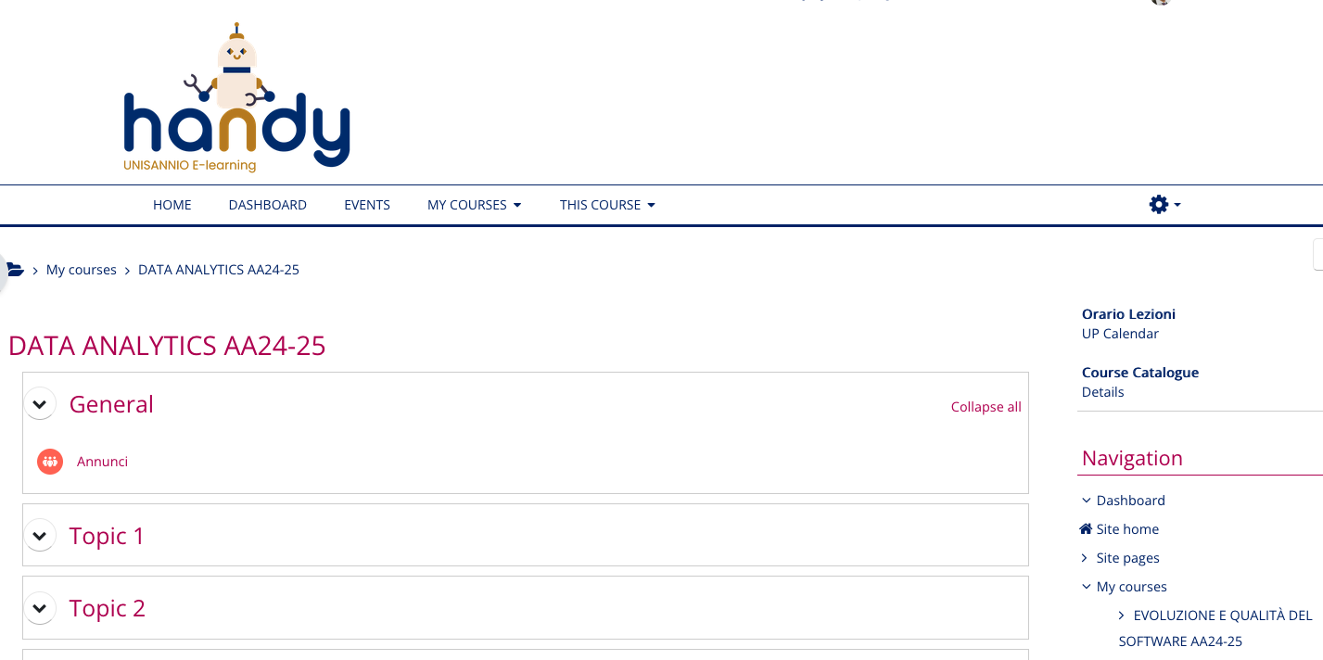

Slide 9
Part 1: Course Overview!

Slide 10
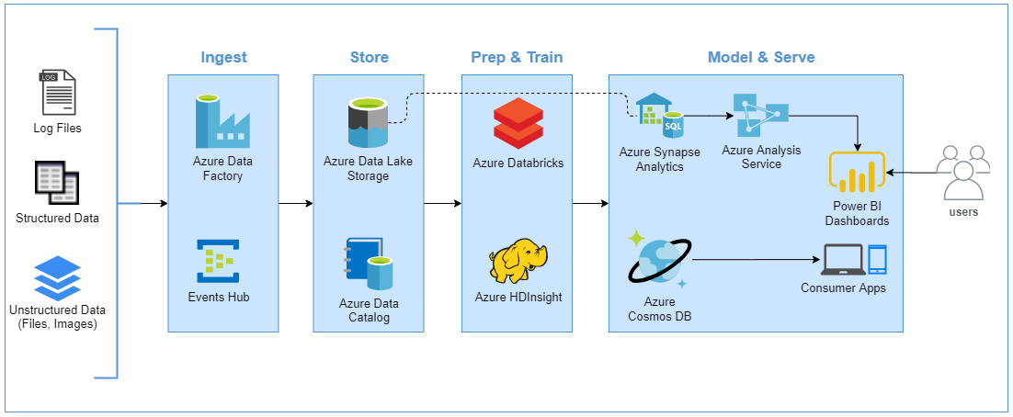
What are we talking about here?

Slide 11
What are we talking about here?

Slide 12
Disciplines Involved
Pure Data engineering
Data Analytics Setup
Data Operations

Slide 13
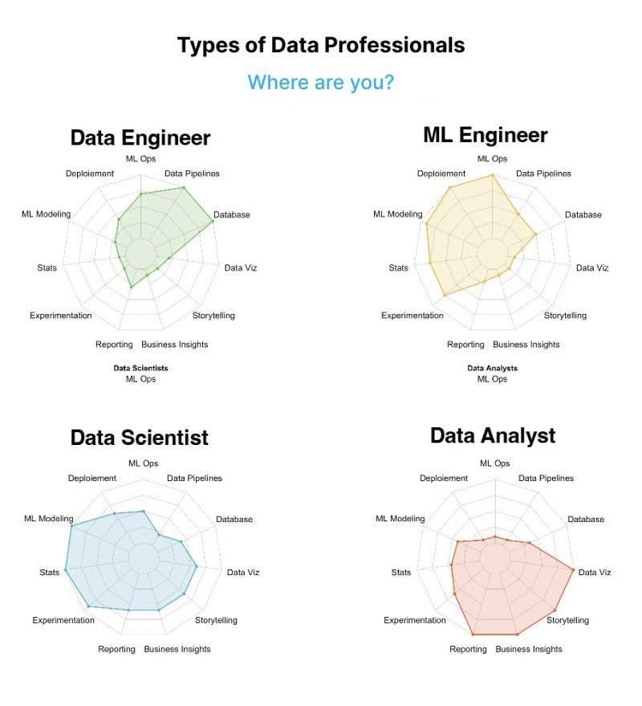

Slide 14
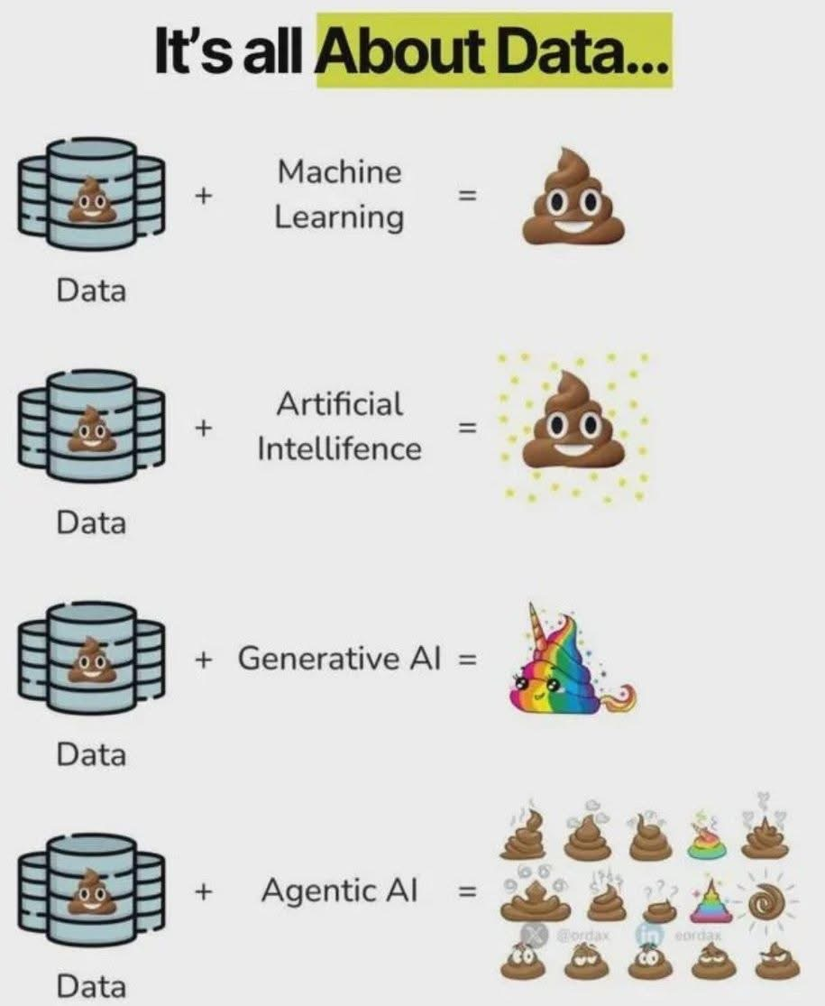
But…

Slide 15
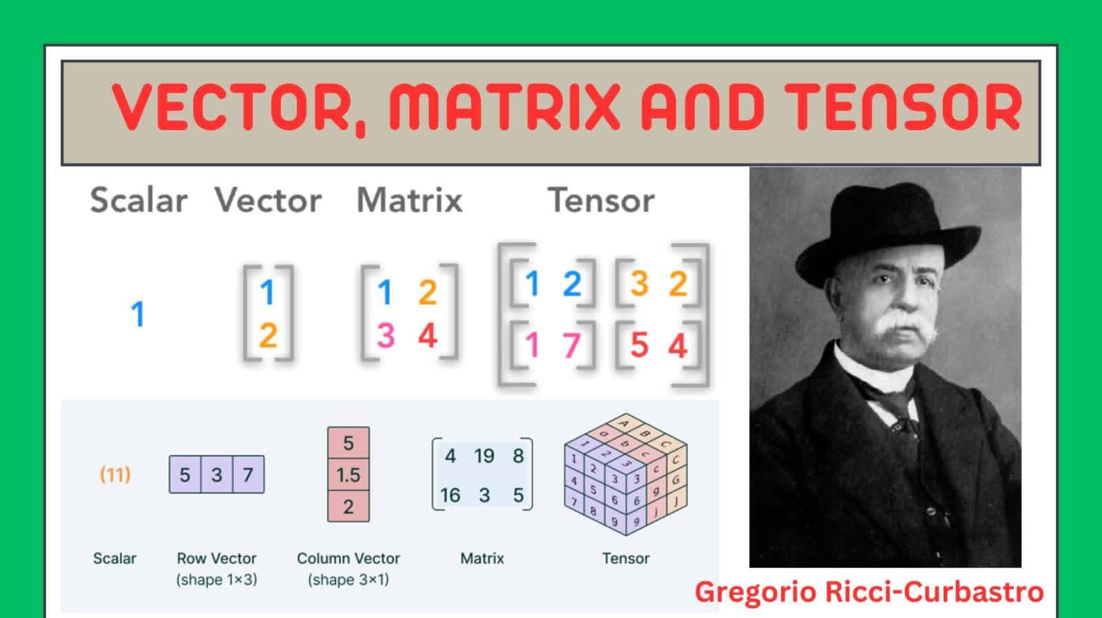
Starting point: different data representations…

Slide 16
Course Structure in Blocks
Strategies
BI
Reporting
Basics
Intro
Data Engineering
Data Analytics / Learning Strategies
The Science of it All
Data Operations
EMSE
No-free-lunch
Instances
BV-tradeoff
Assoc.RM
Dec.Tree
SVMs
MLOps
In-Action!
Industry

Slide 17
Delivery Structure
Full-frontal Lecture (like today ☺)
Team-based project work
Flipped Classrooms & Esercitazione:
You will do the work live, but we’ll discuss it together!
Your Presentation (one group/example), our Q&A Afterwards

Slide 18
Delivery Structure
Full-frontal Lecture (like today ☺)
Team-based project work
Flipped Classrooms & Esercitazione:
You will do the work live, but we’ll discuss it together!
Your Presentation (one group/example), our Q&A Afterwards

Slide 19

Teams’ Structure & Details
Working in teams is an essential characteristic of any Data analytics Effort, we’ll test it together as well!
Project work is essential part of course evaluation!
Teams of 4 people max., enroll here:

Slide 20
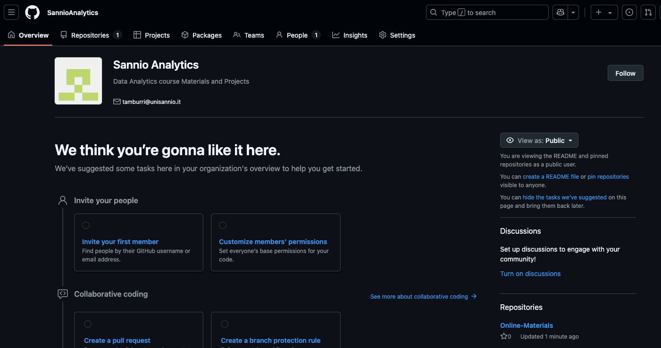

Slide 21
Project Work Specifications
Here’s what to do:
Form a team and enroll as above;
Find a dataset, find one which appeals to you, formulate a research plan! More on this later ☺
Investigate through it, study contents;
Descriptive statistics + feature engineering;
Research Design Motivation + Dataflow model / workflow;
Evaluate results + Discussion;
Ask me questions if needed…
Get started ASAP!

Slide 22
Project Work Specifications
Here’s what to do:
Form a team and enroll as above;
Find a dataset, find one which appeals to you, formulate a research plan! More on this later ☺
Investigate through it, study contents;
Descriptive statistics + feature engineering;
Research Design Motivation + Dataflow model / workflow;
Evaluate results + Discussion;
Ask me questions if needed…
Get started ASAP!

Slide 23

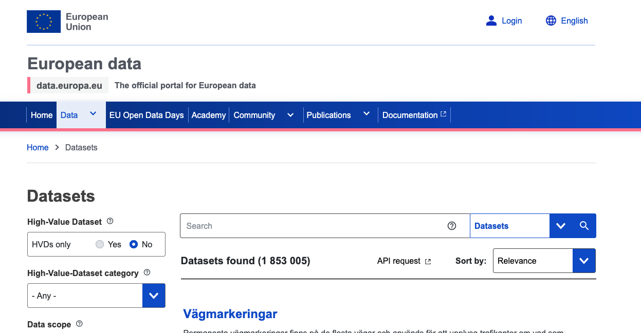
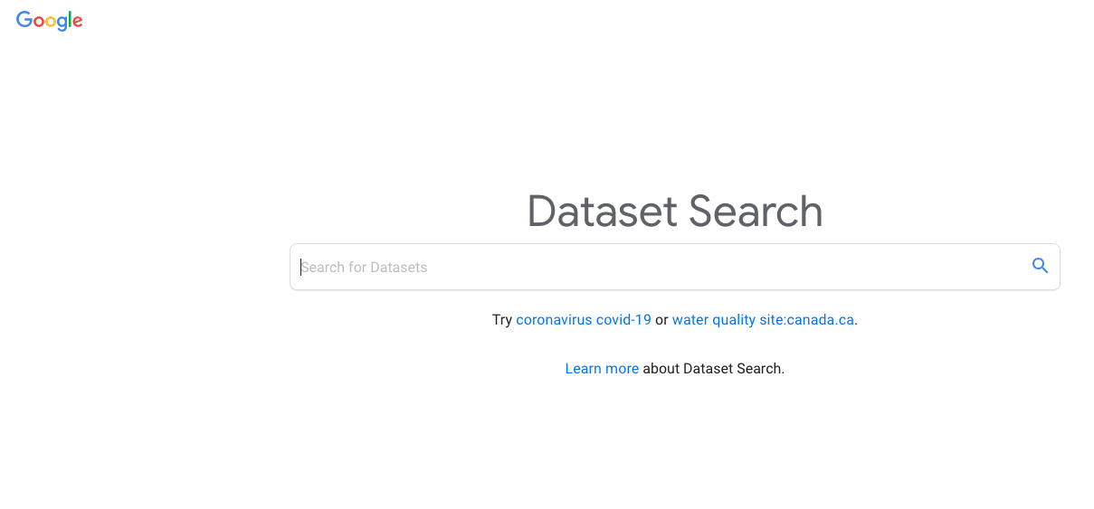

Slide 24
The grand challenge this year!
WJ PROJECT TO ADD HERE

Slide 25
Project Work: Delivery
IEEE 2-column format (PDF)
https://www.overleaf.com/latex/templates/ieee-conference-template/grfzhhncsfqn
Max 10 pages
Must include at least
Intro to problem (with references)
Specification of ML Canvas
Specs over CRISP-DM campaign
Background and related work (with references)
Related works on the same topic/approach/domain
Unused methodologies
Research/solution design
Dataset specification
Data & Feature engineering
Choice of modelling approach with rationale
Results
Explanation and outline of results
Plots to substantiate
Visualizations as opportune
Discussion
Conclusions

Slide 26
Project Work: Delivery (cont’d)
Presentation! [Last scheduled Lecture]
Must be a pitch (10 mins at most)
Overtime ➔ -2 points! Track your time!
Focus on problems and how you solved them
Focus on eventual solution and results
Counts as 3/30 of Project Work, take it seriously ☺
NOTE: There will be an additional moment to showcase plans / partial results!

Slide 27
Delivery Structure
Full-frontal Lecture (like today ☺)
Team-based project work
Flipped Classrooms & Esercitazione:
You will do the work live, but we’ll discuss it together!
Your Presentation (one group/example), our Q&A Afterwards

Slide 28
4 Practicums*
Planning/Executing an Analytics Campaign!
MLOps in Action: SmartShaped Tech. Seminar!
Naive Learning Strategies in Action!
Shallow ML in Action!
*project team discussions will cover ALL of them ➔ obligatory to pass course!

Slide 29
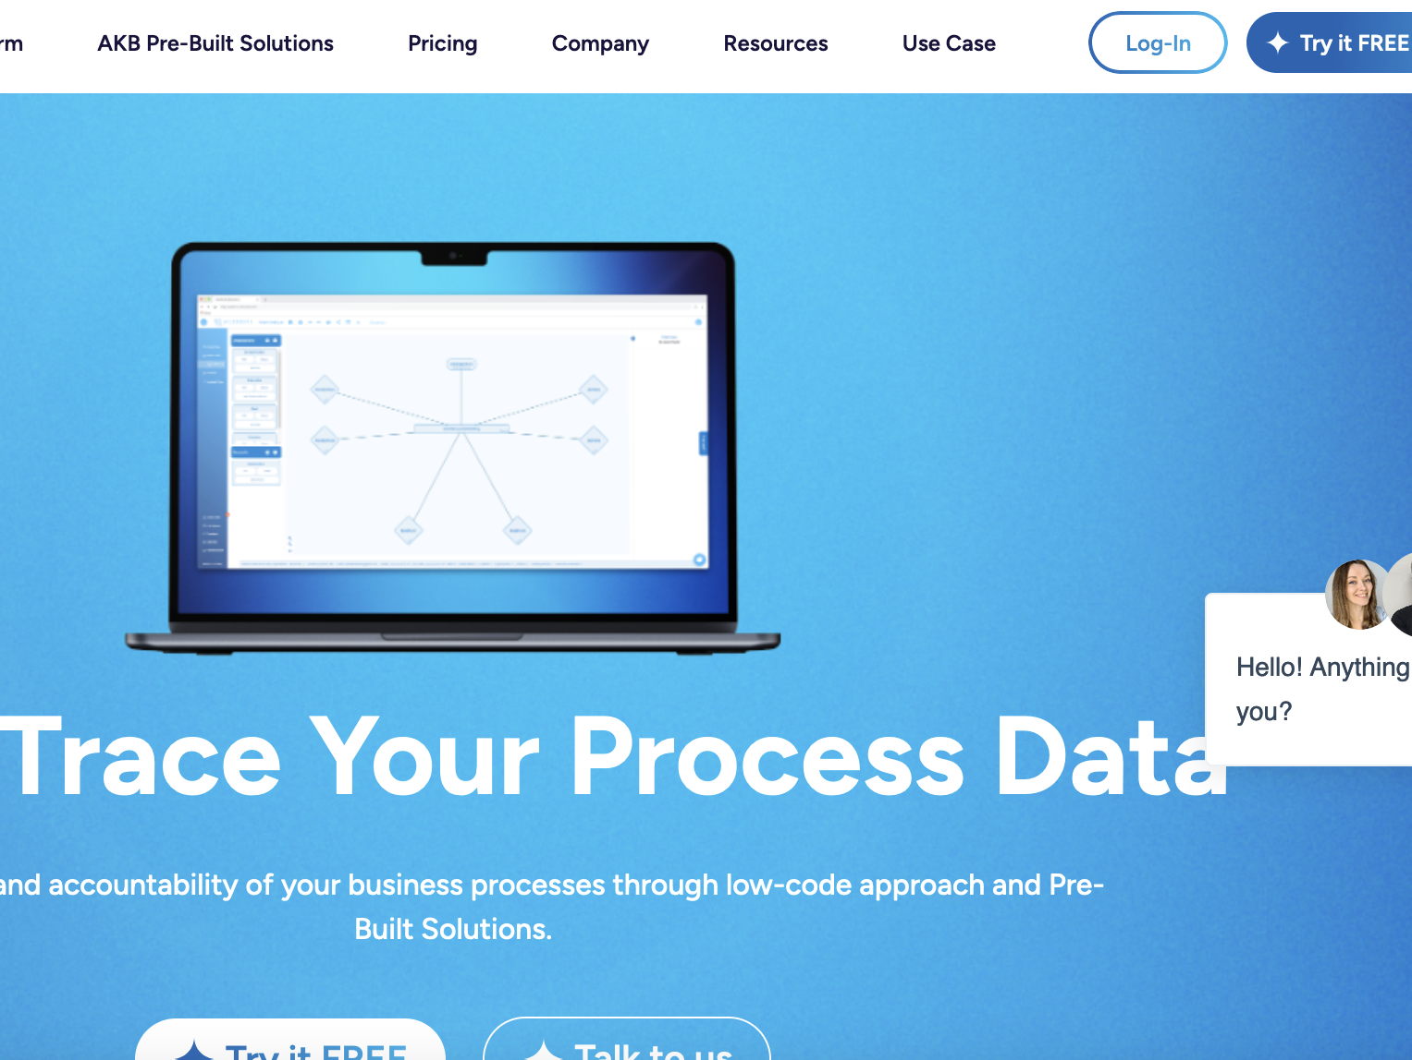
AstraKode s.r.l.

Slide 30
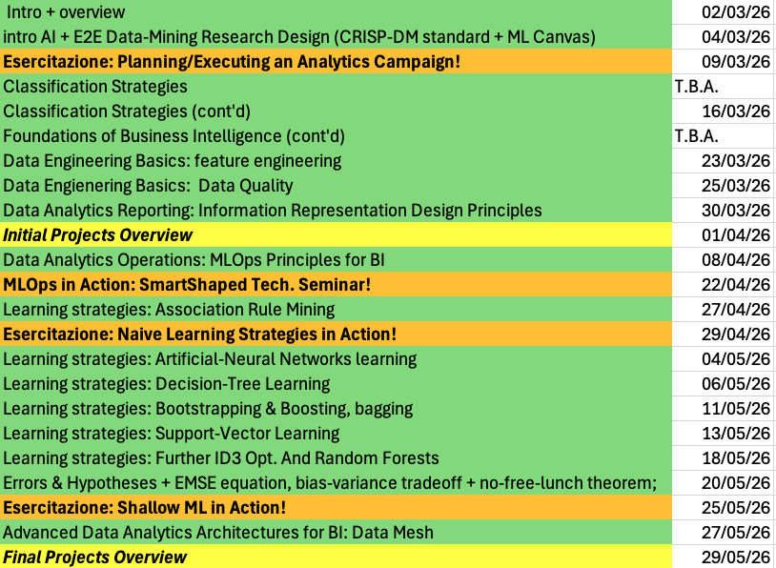

Slide 31
Part 2: Intro & Basic Notions

Slide 32
Foundation of Data Analytics: Business Intelligence http://en.wikipedia.org/wiki/Business_intelligence
computer-based techniques used in spotting, digging-out, and analyzing business data
BI technologies provide historical, current, and predictive views of business operations
Common functions of business intelligence technologies are reporting, online analytical processing, analytics, data mining
Business intelligence aims to support better business decision-making

Slide 33
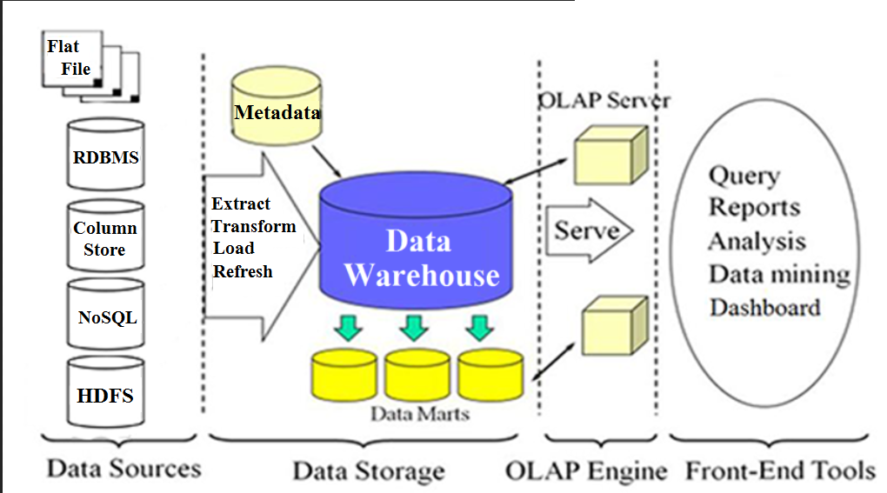
Business Intelligence System Architecture
On-Line Analytical Processing

Slide 34
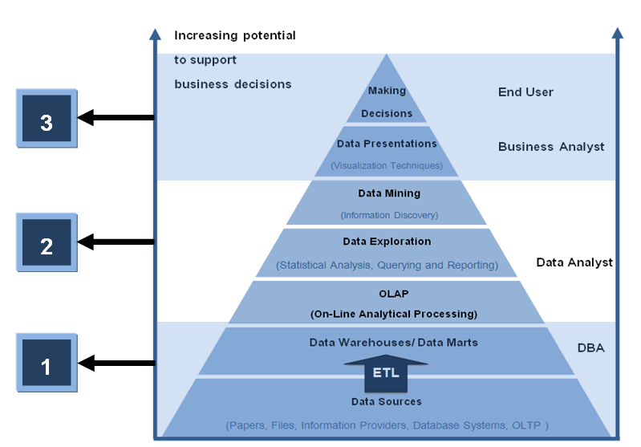
Data Workflows & Data Mining => BI
BI

Slide 35
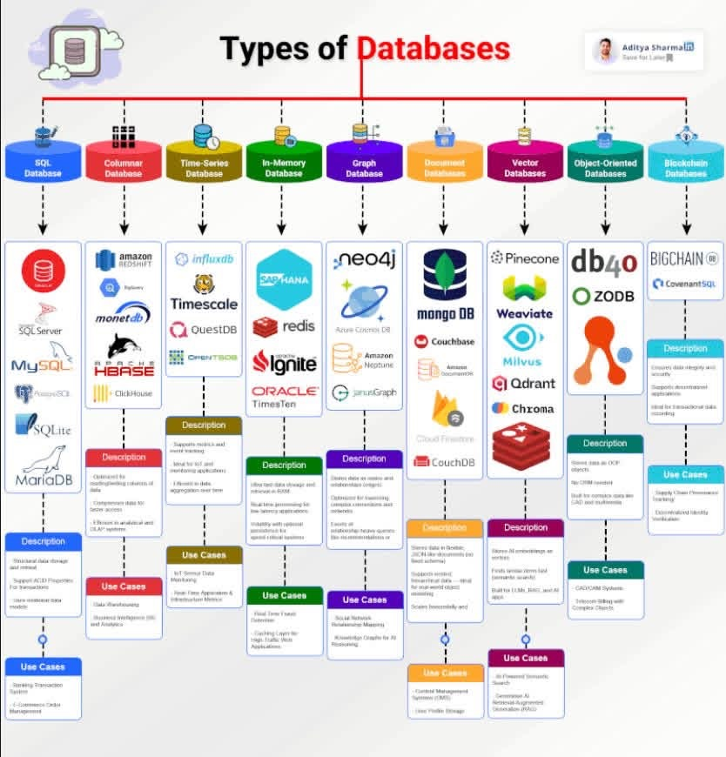

Slide 36
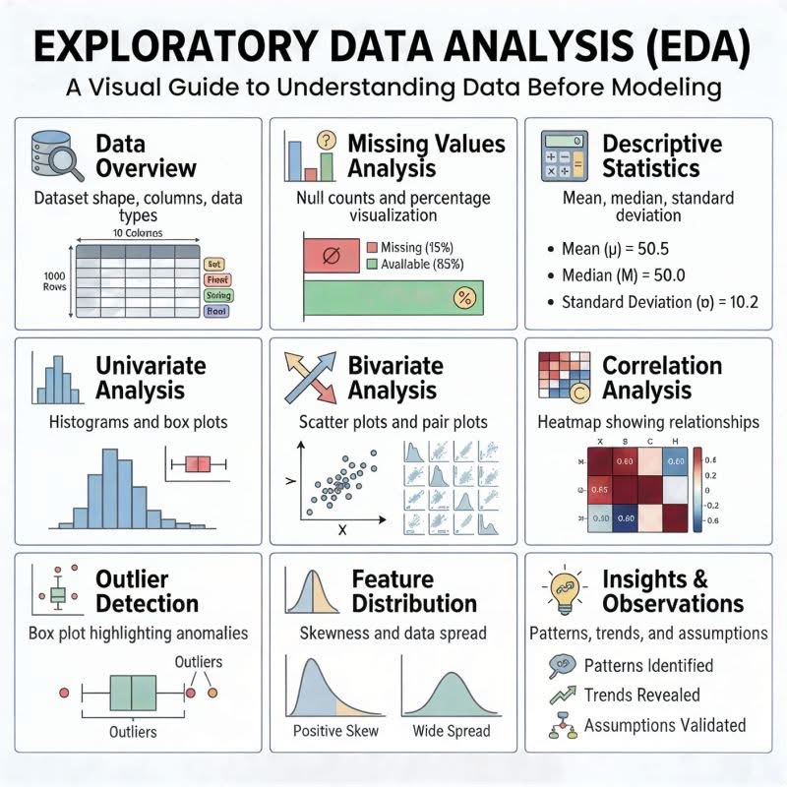

Slide 37
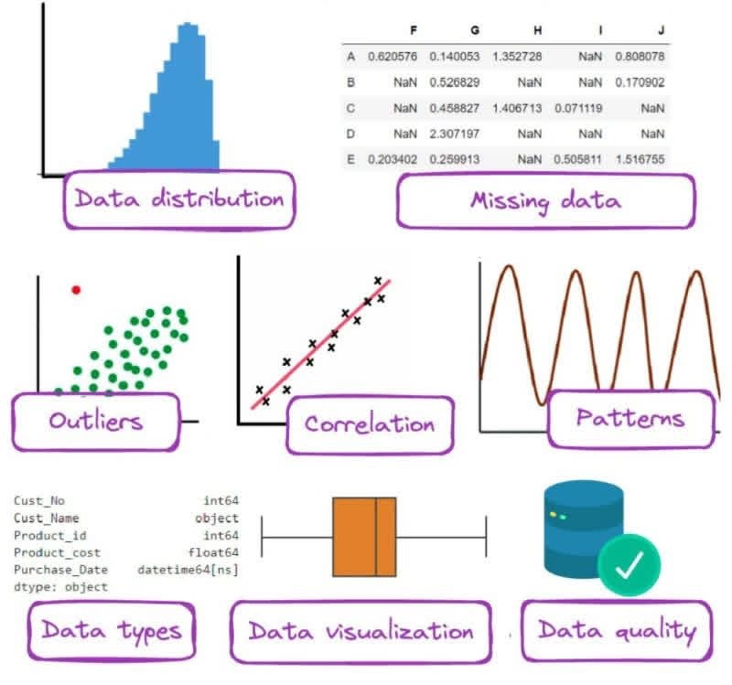

Slide 38
Data Analytics vs. Statistics (my first question back in 2013)
Data Mining | Statistics or Something Else? at http://www.daa.com.au/analyticalideas/datamining.html (change to https://www.daa.com.au/articles/analytical-ideas/ )
DATA MINING AND STATISTICS: WHAT IS THE CONNECTION? At http://www.tdan.com/i030fe01.htm (change to http://tdan.com/data-mining-and-statistics-what-is-the-connection/5226)
Data mining Techniques at http://www.statsoft.com/textbook/stdatmin.html#eda1 (change to http://www.statsoft.com/Textbook/Data-Mining-Techniques#eda1)
CRoss Industry Standard Process for Data Mining (CRISP-DM) at http://www.crisp-dm.org/ (no longer available since around 2012?) https://www.kdnuggets.com/2014/10/crisp-dm-top-methodology-analytics-data-mining-data-science-projects.html
look at Process Model of CRISP-DM 1.0

Slide 39
Statistical methods
Level of measurement of variable:
Qualitative (nominal, ordinal)
Quantitative (interval, ratio or scale)
Variable: Dependent or Independent/Predictor
Descriptive statistics
Qualitative: frequency & percentage
Quantitative: mean & SD
Inferential statistics: from sample statistics make inference to population parameters via the process of statistical hypothesis testing (test is significant or not)
Do analysis on sample data and make inference to population parameters of interest
Validity of conclusion depends on sample that is a good representation of population

Slide 40
Steps in statistical hypothesis testing
Formulate hypothesis: H_{o} and H₁
Set level of significance (α = 0.05, 0.01, 0.10)
Statistics used to test hypothesis in (1)
This statistics is called “Inferential statistics” Formulae (don’t need to know)
Has distribution (Z, t, F, χ²) under H_{o}
Decision rule: Reject H_{o} if P-value < α
Calculate statistics and p-value
Statistical package gives these values
Make decision: Reject H_{o} or Do not reject H_{o}
Reject H_{o} means that the test is significant

Slide 41
Type I and Type II errors
Table of error types |  | Null hypothesis (H₀) is
 |  | True | False
Decision About Null Hypothesis (H₀) | Reject | Type I error (False Positive) α | Correct inference (True Positive) Power of the test (1 – β)
 | Accept (Do not reject) | Correct inference (True Negative) Confidence Level (1 – α) | Type II error (False Negative) β

Slide 42
Most common Statistical Modeling
Linear Regression
Logistic Regression
Structural Equation Modeling (SEM)
with LISREL http://www.ssicentral.com/lisrel/
with Mplus https://www.statmodel.com/
Goal of Statistical Modeling is to empirically assess theory (confirmatory data analysis)
Confirmatory data analysis vs Exploratory data analysis

Slide 43
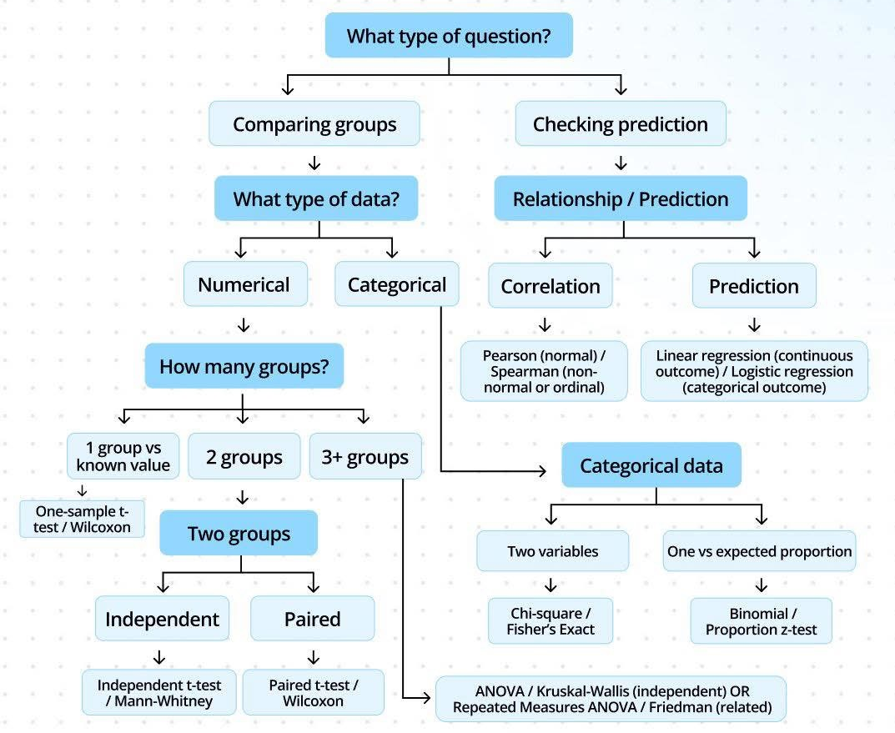
Choosing the right stats?

Slide 44
Analytic Modeling
Many Analytical Approaches
Machine Learning (ML) algorithms (many algorithms for same type of problems
Metaheuristics
Instance-based/Naïve
(Typically) Two sets of data: Training set & Test set (should be independent)
Training set: Build a model
Test set: Evaluate the model
“Data analytics is an experimental science supported by mathematical means, rather than the other way around” (cit. Witten, paraphrased)

Slide 45
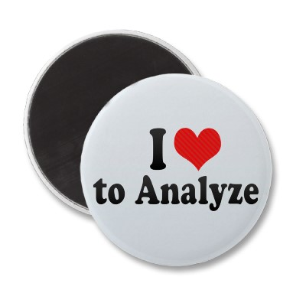
Data Analysis
Analysis: Turning raw data
into useful information
Purpose: To provide answers to questions being asked by a health program
Even the greatest amount and best quality of data mean nothing if data are not properly analyzed—or analyzed at all.
Notes:
Although the terms “data” and “information” often are used interchangeably, there is a distinction.
Data refers to raw, unprocessed numbers, measurements, or text.
Information refers to data that are processed, organized, structured, or presented in a specific context. The process of transforming data into information is data analysis.
NOTE to facilitator: Read slide.

Slide 46

Data Analysis
Analysis does not mean using a computer software package.
Analysis is looking at the data in light of the questions you need to answer:
How would you analyze data to determine: “Is my program meeting its objectives?”
Notes:
Data analysis does not necessarily mean using a complicated computer analysis package. It means taking the data that you collect and looking at them in the context of the questions that you need to answer.
For example, if you need to know whether your program is meeting its objectives, or if it’s on track, you would look at your program targets and compare them to the actual program performance. This is analysis.
Later, we will take this one step further and talk about interpretation. (For example, through analysis, you find that your program achieved only 10% of its target; now you have to figure out why).

Slide 47
Answering Program Questions
Question: Is my program meeting its objectives?
Analysis: Compare program targets and actual program performance to learn how far you are from the targets
Interpretation: Why have you achieved or not achieved a target, and what does this mean for your program?
Answering may require more information.
Notes:
With regard to data demand and use (DDU), we talk a lot about answering programmatic questions. Let’s take a minute to discuss what that means.
Suppose you need to know if your program is on track. You probably would look at your program targets and compare them to the actual program performance. This is analysis.
Interpretation is using the analysis to further explore your findings and understand the implications for your program. In many cases, this means using additional information, such as vital statistics, population-based surveys, and qualitative data, to supplement the routine service statistics.
NOTE to facilitator: Read the slide.

Slide 48
Descriptive Stats & Analysis
Describes the sample/target population (demographic and clinical characteristics)
Does not define causality; tells you what, not why
Example: Average number of clients seen per month
Notes:
The world of data analysis is vast and can be complex. In this course, we focus on descriptive analyses that will be most helpful in the. This unit reviews the most common data analysis terms and techniques used for descriptive analysis. In the next session, we’ll apply these techniques to monitoring and evaluation (M&E).
NOTE to facilitator: Read the slide.

Slide 49
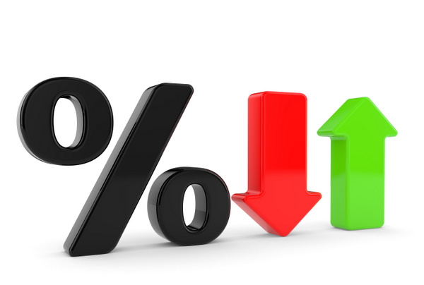
Basic Terminology and Concepts
Statistical terms
Ratio
Proportion
Percentage
Rate
Mean
Median
Trend
Notes:
This slide lists the basic statistical terms used in data analysis. In this session we will mostly be covering the mean , median, and trend.

Slide 50
For example: a Trend
A trend is a pattern of gradual change in a condition, output, or process, or an average or general tendency of a series of data points to move in a certain direction over time, represented by a line or curve on a graph.
To follow a trend you must not only be aware of what is currently happening but also be astute enough to predict what is going to happen in the future.

Slide 51
Plotting Trends
Notes:
When information is available across several points of time, a trend estimation can be helpful to interpret the data and observe increases, decreases, or static behavior. There are different periods to consider when deciding how to observe the trend in data. Data can be observed from century to century, decade to decade, year to year, month to month, or day to day.
Analyzing trends in data can be incredibly helpful to look at when changes occurred, which can assist in determining why this change may have occurred. Trend estimates can also be helpful to do a quick projection of data. Overall, in the most basic form, trends can help us determine if we are on track to meeting targets, and if program or policy changes are moving outcomes in the direction we intend.
Trend data are often best displayed using a line graph.
The graph above shows # of adults on ART and # children on ART for 2008, 2009, 2010, and 2011. For both indicators there is a general upward trend.

Slide 52
What can I do with Trends?
Notes:
This graph compares the same indicators but month-by-month only for the year 2011. The trend for adult treatment is a general increase through July, then a sharp decrease and steady decline through the end of the year. The trend for treatment of children is a gradual increase through October, with a slight dip down and stagnant level observed for the last two months of the year.
Say these data were taken from all treatment sites in one province. The graph on the previous slide would lead us to believe that this province is increasing ART treatment both for adults and children. Consequently, if we were to make a decision for this province―for example, to set their 2012 targets―we may aim high given the rate at which the site has been able to grow clients.
Conversely, the graph on this slide may cause us to reconsider, given the sharp decrease in adult treatment from July–December. Instead of assigning higher targets and suggesting that this province is performing well, we may instead be concerned about the performance of this province. In that case, we will seek to explain the dip in July, and explore how we can reverse the downward trend. In setting the program’s targets, we may consider something closer to the 2011 achievements, in hopes that the program can get ART enrollment back up to where it was earlier in the year.
NOTE: The 2011 summary data for #adults on ART has been the median value of the month of July which was at 180. It would have been preferable to take the mean of the 2011 data for #adults on ART which will be substantially lower than 180.

Slide 53
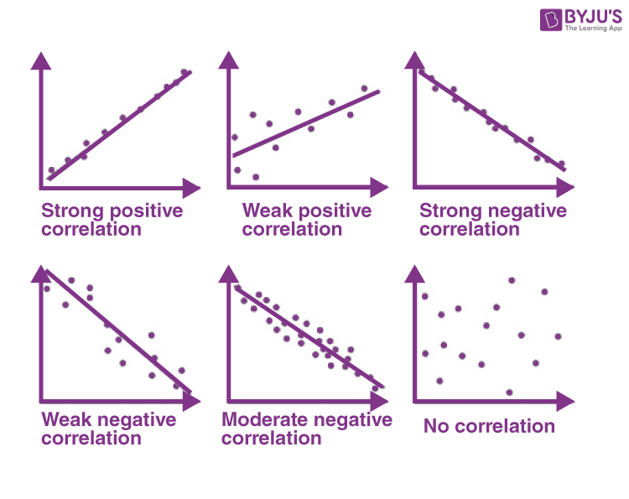

Slide 54
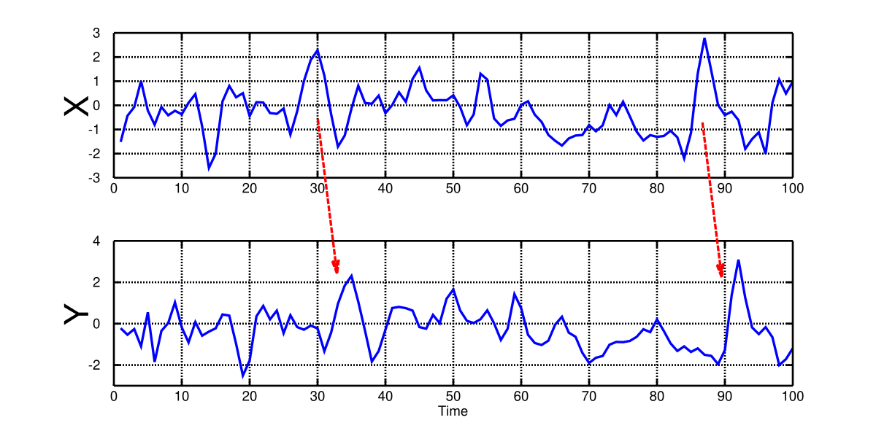
Causality Testing*
*image courtesy of Granger Causality Testing on Wikipedia

Slide 55
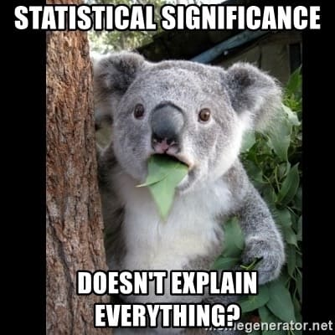
Testing! Testing! Testing!
Statistical Description + Testing ➔ Feature Engineering!

Slide 56
SELECT THE RIGHT VISUALIZATION

Slide 57
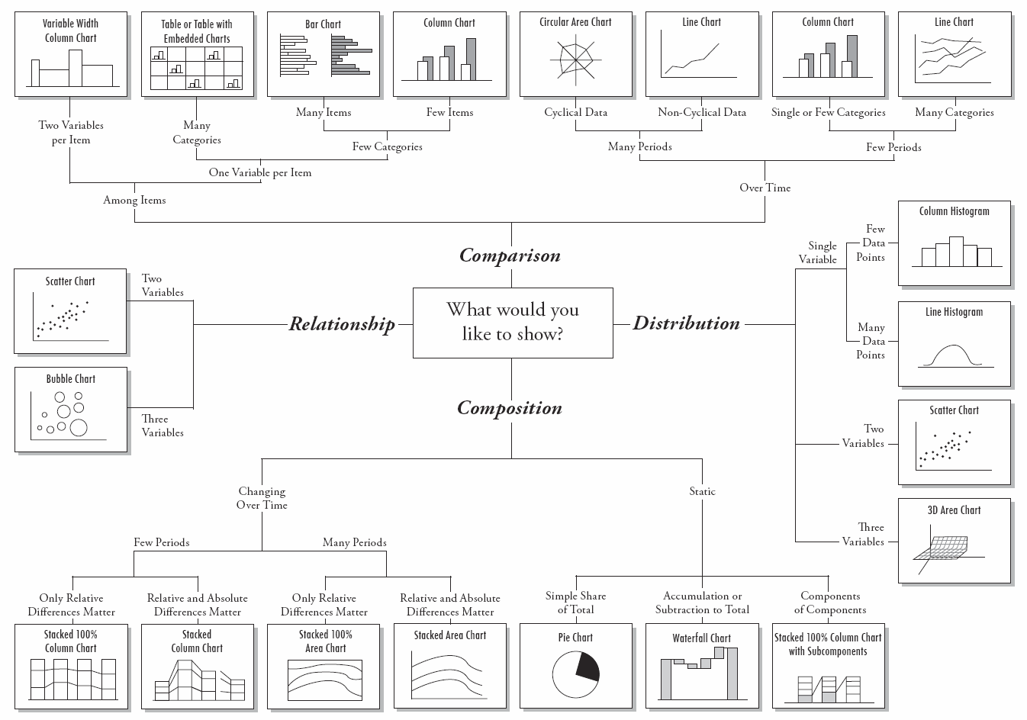
Types of Visualizations
Notes:
This slide shows a broad spectrum of charts depending the types of questions you want to address and the types of variables you have in hands.

Slide 58
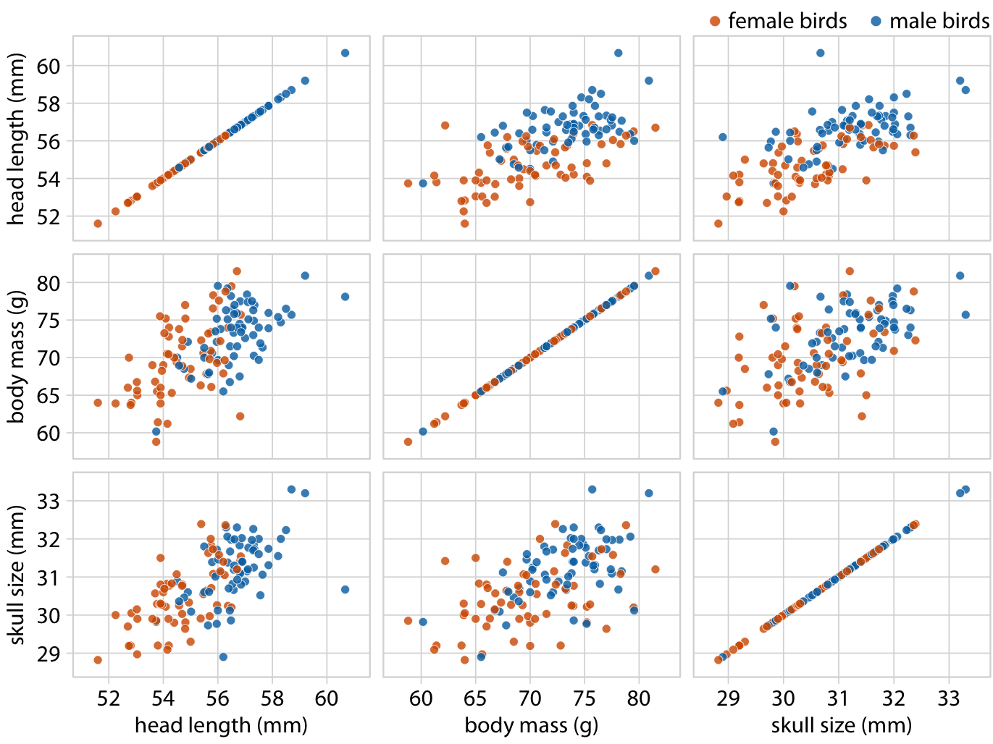
Draftsman Plot*
*A method for looking at the interrelations between variables in multivariate data. The plot consists of a simple array of two-variable scatter diagrams.

Slide 59

Questions?

